Slide 1

TRANSITION SLIDE (White on Maroon)

Slide 2

ProcPIPE: Offloading processing pipelines on Computational Storage
-- Shashwat Jain
Changwoo Min, Asst. Professor, Dept of ECE @ Virginia Tech
Notes:
Good Morning everyone, today I will be presenting our work that we call as ProcPIPe, which is a framework that enables application to offload computational pipelines to computational storage.

Slide 3
OUTLINE
1

Slide 4
Quote Callout
OUTLINE
The Problem
Computational Storage Device and Issues
Solution: ProcPIPE
KVS Background
Arbiter: Computational Pipeline IP
Implementation
Putting it all together
Evaluation
Conclusion
2
Notes:
First I would like to introduce the problem that lays the foundation for our project’s motivation.
Go on to discuss CSDs and the legacy issues with them
We propose our solution to those issues with ProcPIPE

Slide 5
THE PROBLEM
3

Slide 6


Quote Callout
The Bottleneck!!!
PERFORMANCE SATURATING
OVER YEARS
PERFORMANCE INCREASING
OVER YEARS
D1
D2
D3
D4
D5
CPU
STORAGE
D1
CPU BOTTLENECKS!!!
I/O UNDERUTILIZED!!!
4
Notes:
Over the years compassing a past few decades. There has been an exponential increase in CPU performance until the recent years where this trend is saturating and deviating the ever popular moore’s law. This phenomenon is accompanied by advancement in the storage technology and hence increase in storage transfer speeds.
Now the question is what does this lead to?
Well as you can see the data movement is much faster than what CPU can process.
Well it leads to 1) CPU bottleneck. 2) I/O of storage is under utilized. So there is an imbalance that needs to be improved.
This problem even becomes bigger in modern use cases such as as training of deep learning models. Where huge amount of dataset is fed but CPU bottlenecks the preprocessing.

Slide 7
SOLUTION?
5

Slide 8
Quote Callout
BRING COMPUTATION NEAR STORAGE
ACCELERATOR
NEAR STORAGE COMPUTATION
NO NEED FOR UNECCESARY DATA MOVEMENT TO CPU MEMORY!
CPU NOT A BOTTLENECK ANYMORE!
6
Notes:
One solution is what if the processing itself comes near to the storage. This is a well-known idea commonly called as near storage computation where a storage device is generally directly interfaced with an accelerator.
How does this help our case?
Well, it removes the need of any unncecessary data movement from the drive to the CPU memory.
Second, it relives the CPU of the bottleneck that we discussed.

Slide 9
Quote Callout
COMPUTATIONAL STORAGE DEVICES (CSDs)
NVMe
ACCELERATOR – FPGA
STORAGE – NVMe DRIVE
DDR RAM (CMA) – MAPPED ON THE PCIe BUS
FPGA
COMMON MEMORY AREA (DDR RAM)
SAMSUNG SMARTSSD
ANY ISSUES?
YES!!!
7
Notes:
Going further onto the near storage computation idea. Now I would like to introduce what a computation storage device is.
Apart from an accelerator and a storage device it also consists of one major component called the common area memory which is basically a shared DDR RAM between the FPGA and SSD.
Anything that needs to be processed by the FPGA, the corresponding data is stored onto this CMA and then the FPGA accesses it and computes.
In our project we leveraged Sasmsung Smart SSD and its has an NVMe storage drive coupled with an FPGA which is our accelerator and then a 4GB DDR RAM or CMA.
In a nutshell a CSD consists of an accerlator, ddr ram and a storagte drive.
So everything looks good to go right?
Well no we have issues.

Slide 10


Quote Callout
ISSUES WITH CSDs
1. Processing Pipelines supported by programming frameworks are “hardwired.”
HOST APPLICATION
INPUT JPEG
INPUT DATA
PAYLOAD
OUTPUT DATA
PAYLOAD
OUTPUT JPEG
KERNEL
COMPUTATIONAL TASK
CROP
FLIP
JPEG DECODE
KERNEL
2
KERNEL
3
KERNEL
1
HARDWIRED COMPUTATIONAL PIPELINE
* LACK OF FLEXIBILITY
* STATIC LOGIC
8

Slide 11
Quote Callout
ISSUES WITH CSDs
2. CSD frameworks don’t support “multi-tenant sharing.”
COMPUTE ORDER
K1 -> K2 -> K3
HOST APPLICATION 1
HOST APPLICATION 2
COMPUTE ORDER
K3 -> K2 -> K4
CSD
HARDWIRED
PIPELINE
DEEMED UNUSABLE
COMPUTE RESOURCES
MEMORY RESOURCES
MULTIPLE APPLICATIONS SHARING CSD
* LACK OF USABILITY (CLOUD PLATFORMS)
* RESOURCE WASTAGE
9

Slide 12

Quote Callout
ISSUES WITH CSDs
3. “Host Application logic and resource management dependency” – Programming Headache
* CUMBERSOME PROGRAMMING INTERFACE * NOT APPLICATION AGNOSTIC
10

Slide 13
SOLUTION?
WE PRESENT…
“ProcPIPE”
11

Slide 14
Quote Callout
THE PROPOSAL
HOST
ARBITER KERNEL
“Delegate resource (compute and memory) management to the accelerator.”
LEVERAGE RETINA KVS
“in house Key Value Store designed intricately for computational storage”
FLEXIBLE PROGRAMMING INTERFACE
“host application freed from processing pipeline handling burden”
LOOKUP IMAGE
EXECUTE PIPELINE (DYNAMIC ORDER)
EXECUTE (bat.jpg, [JPEG_decoder, Crop, Flip]) - DYNAMIC
CMA
Preprocessed
bat.jpg
[bat.jpg]
P2P
DEVICE DRAM (CMA)
[bat.jpg]
[cat.jpg]
P2P
LBA 0
LBA 1
SSD
FPGA
SMART SSD
ARBITER
preprocess bat.jpg
& write to CMA
BLACK BOX
12
Notes:
We will fill in this diagram with our module details going forward. But this is what we want to achieve in simple terms.

Slide 15
Retina: The Cross-layered KVS BACKGROUND
13

Slide 16
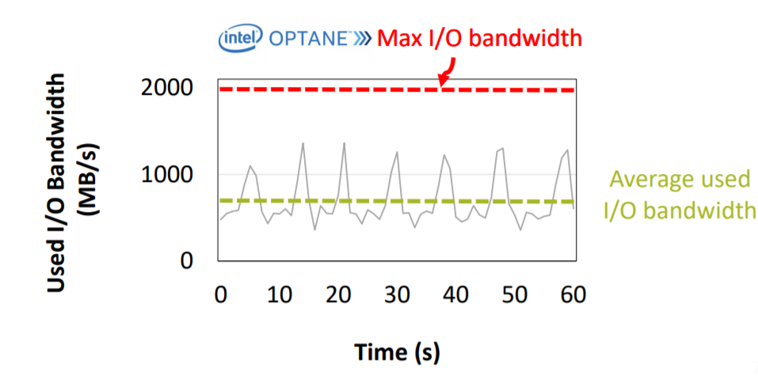
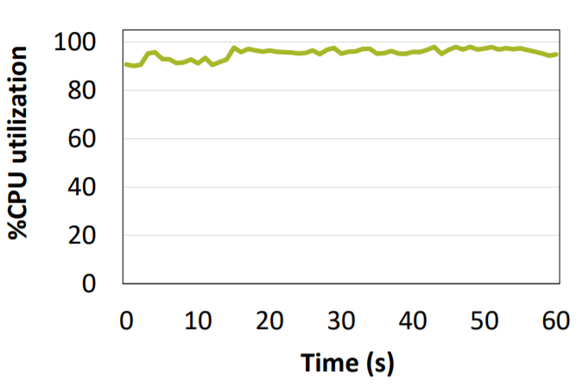
Quote Callout
Retina KVS
Why do we need a new KVS?
traditional KVs not designed to optimally use the CSD architecture.
RocksDB 50% GET, 50% PUT ⇒ CPU bound
14

Slide 17
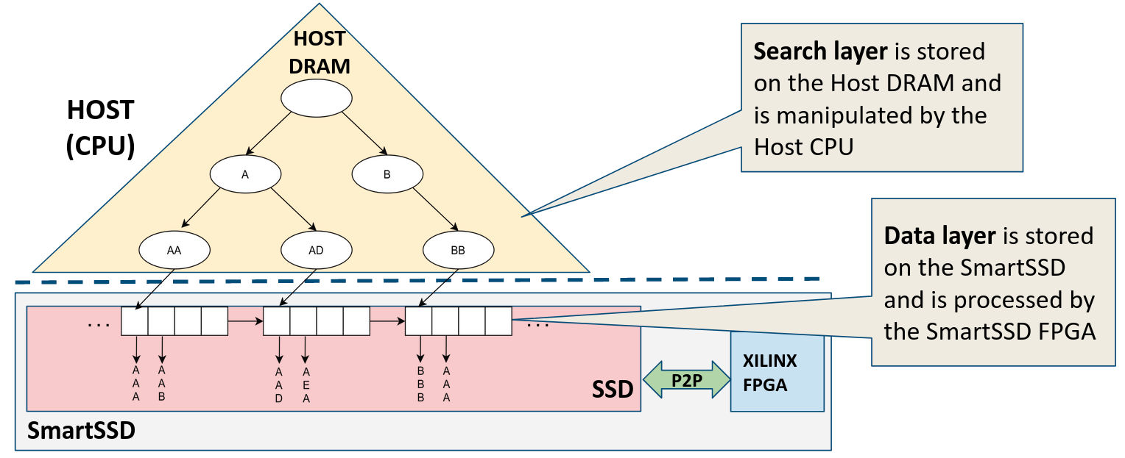
Quote Callout
Retina: The Cross-Layered Structure
Host CPU acts as a control plane:
triggering FPGA kernel calls, issuing data transfers to/from SSD etc.
FPGA performs pure computation:
operations of the data plane, manipulating and handling data.
15
Notes:
CPU traverses the search layer, retrieves the LBA and loads the data node to the CMA.

Slide 18
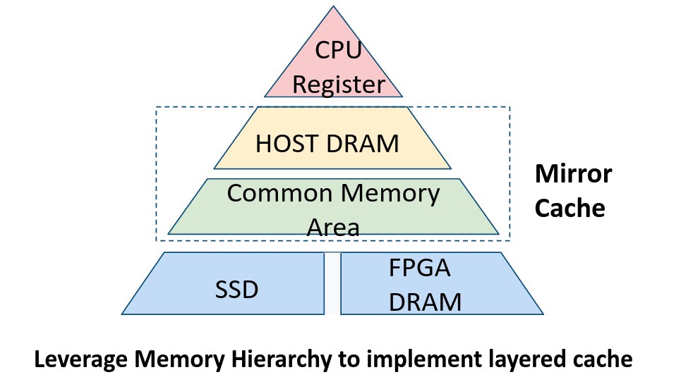
Quote Callout
Retina KVS : Mirror Cache
Avoid loading pages into FPGA DDR at every read/write.
Uses the Common Memory Area (CMA) to cache recently accessed pages and Host DRAM to cache its corresponding metadata.
16
Notes:
RETINA further optimizes the data by implementing a cross-layered caching layer between the host memory and the CMA. A portion of the CMA region is reserved for caching (data cache) the frequently accessed data nodes and to know if a particular data node is present in the data cache RETINA uses a mirror cache in the host memory. Mirror cache prevents additional PCIe hops to check the data cache for the datanode.

Slide 19
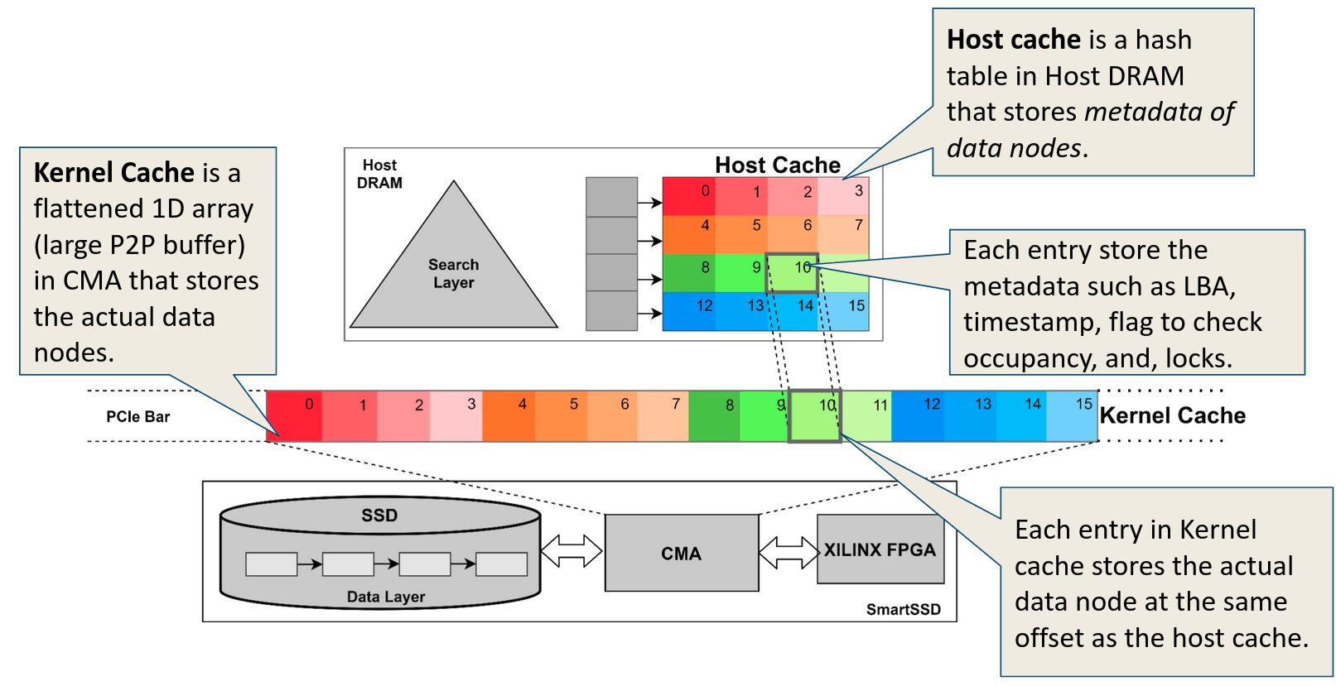
Quote Callout
Retina KVS : Mirror Cache (Basic Design)
17
Notes:
This diagram showcases the basic architecture of the cache design.
As mentioned it prevents additional PCIe hops to check the data cache for the datanode.

Slide 20
ARBITER Computational Pipeline Scheduler
18

Slide 21



Quote Callout
Arbiter: Computational Pipeline Scheduler
“Delegate the power and capability to handle memory management, composing compute functions, scheduling the hosts’ compute requests to the near storage accelerator (e.g., FPGA)”.
“IMPLEMENTED AS A KERNEL IP ON THE FPGA”
FUNCTIONS:
Inter-Kernel and Host Communication
Pipeline Scheduling
Memory Management
19

Slide 22
Quote Callout
Arbiter: Inter-Kernel and Host Communication
communicates with host via streams or memory mapping based on hardware.
inter-kernel communication is through accelerator streams (memory queue to exchange data).
KERNEL
1
In Stream
Out Stream
Memory Mapping
INPUT
ORDER: 1,2,3
HOST APPLICATION
ARBITER KERNEL
KERNEL
3
INPUT
ORDER: 3,1,2
KERNEL
2
20

Slide 23
Quote Callout
Retina Arbiter : Inter-Kernel Communication
Sequence Number | Stage Number | Stage IDs | Buffer Offset In | Buffer Offset Out | Payload
Packet Format for Arbiter_Kernel Communication
Sequence Number (1 Byte): ID corresponding to the pipeline sequence for the current task/input.
Stage Number (1 Byte): What is the current operation happening within the whole pipeline of multiple compute kernels. Index of operation in the pipeline kernel stage list.
Stage IDs (Max Number of Pipeline Stages * 1 Byte): Sequential list of all the compute kernel IDs in the current pipeline.
Sub-Buffer Offset In (1 Byte): Offset of the input buffer in the CMA that holds the output from the previous compute kernel/ Arbiter in the pipeline.
Sub-Buffer Offset Out (1 Byte): Offset of the output buffer in the CMA that will hold the output from the current compute kernel in the pipeline.
Payload (x bytes): holds the kernel specific details (arguments to kernel, configuration)
21

Slide 24
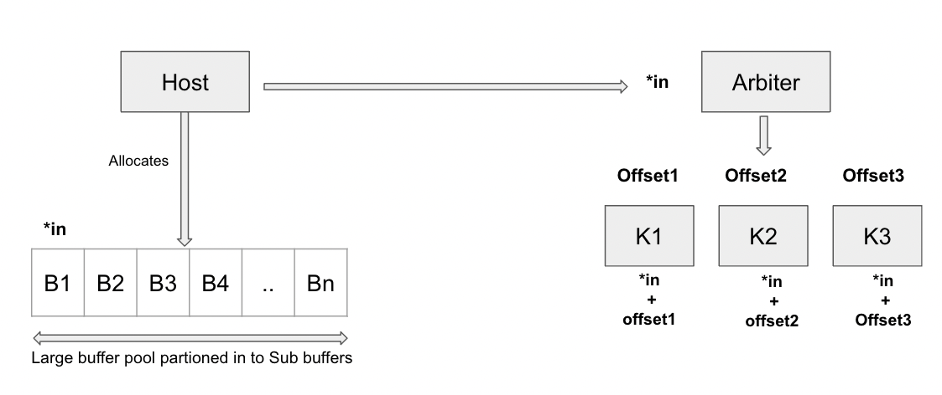
Quote Callout
Retina Arbiter : Memory Management
Host allocates huge memory buffer
Logically sub divided into sub-buffers.
Reference offset to sub buffers shared by arbiter.
Used Sub-Buffers
Available Sub-Buffers
B1(1) | B2(1) | B3(1) | B4(0) | … | Bn(0)
Sub-Buffer Usage State Array
Maintained by Arbiter
22

Slide 25
Quote Callout
Retina Arbiter : Scheduler
HOST APPLICATION
PREPARE TASK PAYLOAD AND SEND FOR EXECUTION
ARBITER KERNEL
BURST ACCESS TASK METADATA
EITHER OF
wq OR rq
IS NON-EMPTY?
NO
POPULATE OUTPUT IN CMA
CUs
&
BUFFER
AVAILABLE?
YES
NO
ADD REMAINING TASKS TO
WAIT QUEUE
COMPUTE PIPELINE OVER?
YES
POLL rq TASK COMPLETION
(LOG FREE BUFFERS/CUs)
YES
EXECUTE TASK ON KERNEL, ADD TO RUN QUEUE
SCHEDULE TASKS FROM wq
(UNTIL RESOURCE EXHAUSTION)
NO
*CUs - COMPUTE UNITS/COMPUTATIONAL KERNEL
*wq - WAIT QUEUE ; *rq - RUN QUEUE
SCHEDULER
23
Notes:
First step for arbiter is to load the batch request from the host. All tasks are now scheduled until either of the compute resource or memory resource has exhausted All scheduled items are added to the run queue and remaining tasks to the wait queue. The main scheduler starts which runs until both the queues are empty. Every iteration running queue is polled for completed tasks. Freed resources are again exhausted by the tasks from wait queue and the process goes on until completion Once tasks is completed host is informed of completion and offset to output results.
Important thing here is that the polling is non blocking, which ensures that the scheduler execution is not blocked and resource utilization is kept to maximum.
If a pipeline is completed (last stage of pipeline catered), we write the output to the host output buffer.

Slide 26
Quote Callout
Retina Arbiter : Design Advantages
Generic and Flexible:
Dynamically composable as opposed to hardwired.
Control Plane shifts to the CSD from the host.
Improves CSDs applicability
Allows sharing CSDs across applications and tenants
highly beneficial for cloud applications
Improves programmability
Offloading compute to CSD is made straightforward and flexible
Dynamic nature of pipelines avoid code changes with change in application pipeline requirement.
24

Slide 27
PUTTING IT ALL
TOGETHER
25

Slide 28
Quote Callout
Retina: The Complete Picture
RETINA provides a standard KVS style APIs which can be used to access the data on the SSD.
bool insert(key_t k, value_t v, compute_t *args, int n_args);
bool update(key_t k, value_t v, compute_t *args, int n_args);
value_t *lookup(key_t k, compute_t *args, int n_args);
Computational Pipeline APIs (Hidden behind these APIs)
26
Notes:
Applications can create a single or an array of compute functions and pass the arguments required for each compute functions
This abstracts all the preprocessing computation from the application and makes programmability easier and flexible.
This information is parsed by the arbiter and the the computational pipeline is handled at the device.

Slide 29
Quote Callout
HOST
0. Lookup (bat.jpg, [JPEG_decoder, Crop, Flip])
MIRROR CACHE
Host DRAM
1. Search Layer (get LBA from name)
2. Value Cached?
hash(bat)
root
“b”
“c”
4. Acquire Lock on DataNode 0
“at”
“at”
3. Value not Cached.
10.
CMA
Preprocessed
bat.jpg
Data Node 0
[bat.jpg]
DATA CACHE
ProcPIPE In Action: The Complete Picture
P2P
DEVICE DRAM (CMA)
Data Node 0
[bat.jpg]
Data Node 1
[cat.jpg]
P2P
LBA 0
LBA 1
10. Output written
to CMA
SSD
FPGA
SMART SSD
ARBITER
5. Lookup bat.jpg (datanode 0 and preprocess)
6
7
8
9
LOOKUP
INSERT
JPEG
DECODER
CROP
FLIP
KVS KERNELS
PRELOADED COMPUTE KERNELS
x. Host CPU Execution
x. Near Storage FPGA Execution
27
Notes:
0: Applications use the RETINA APIs to access the CSD 1: RETINA traverses the search layer using the input key to find the offset of the data node where the key-value pair exists 2: Then it checks the mirror cache to see if the data node is already cached 3: if not then the data node is fetched from the SSD to the data cache 4: If the data node is already cached then RETINA skips step 3 and goes on to acquire the lock on the DataNode-0
5: RETINA invokes the Arbiter kernel on the FPGA
6: Arbiter then executes the lookup operation on DataNode-0 to retrieve the image 7,8,9: Arbiter performs the preprocessing steps in the application specified order 10: Arbiter saves the output to the CMA at a specified location by the host.

Slide 30
Implementation
Integrating Retina with Tensorflow Framework to Offload Resnet-50 Preprocessing to the SmartSSD
28

Slide 31
Quote Callout
Implementation : Integration with Tensorflow
A native file system in Tensorflow
intercepts regular data access and computation tensorflow APIs and then call ProcPIPE APIs internally.
Training Model for Evaluation - ResNet50
Implemented kernels on FPGA
JPEG Decoder
Random Crop
Flip Kernel
29

Slide 32
Quote Callout
Implementation : Integration with Tensorflow
TENSORFLOW DL TRAINING
PREPROCESSED DATA
RETINA FS
PREPROCESSED DATA
RETINA KVS ENGINE
FETCH IMAGES AND PREPROCESS REQUEST
RETINA API CALL
LOOKUP AND CALL PREPROCESSING
COMPUTATIONAL STORAGE DEVICE
ARBITER
PREPROCESSED DATA
KERNEL 1
(x1 instances)
KERNEL 2
(x2 instances)
KERNEL n-1
(x^{n-1} instances)
KERNEL n
(x^{n} instances)
OUTPUT FLOW
INPUT FLOW
COMPUTATIONAL PIPELINE
30

Slide 33
Evaluation
31

Slide 34
Quote Callout
Evaluation Platform:
8-core Intel Xeon Gold 6152 CPU ( 2 NUMA nodes)
1 NVIDIA Tesla V100 GPU
263 GB DRAM Memory
Smart SSD
Samsung NVMe SSD (PCIe Gen3, 3.84TB capacity)
Xilinx KU15P FPGA
4GB accelerator dedicated DRAM mapped to the PCIe bar address (CMA)
32

Slide 35
Quote Callout
Evaluation Configuration:
6 Compute Kernels Implemented and tested (JPEG Decoder, Snappy File Compression, Flip, Crop, and Resize)
6 KVS Kernels (lookup, insert, update, delete, split, and merge)
CMA(Common Memory Area) Distribution: (4 GB)
Data Cache (KVS) - 2GB
Mirror Cache consumes 512MB Host Memory
FPGA Kernel Concurrency - 1 (Lack of compute units in the Xilinx KU15P FPGA)
33

Slide 36
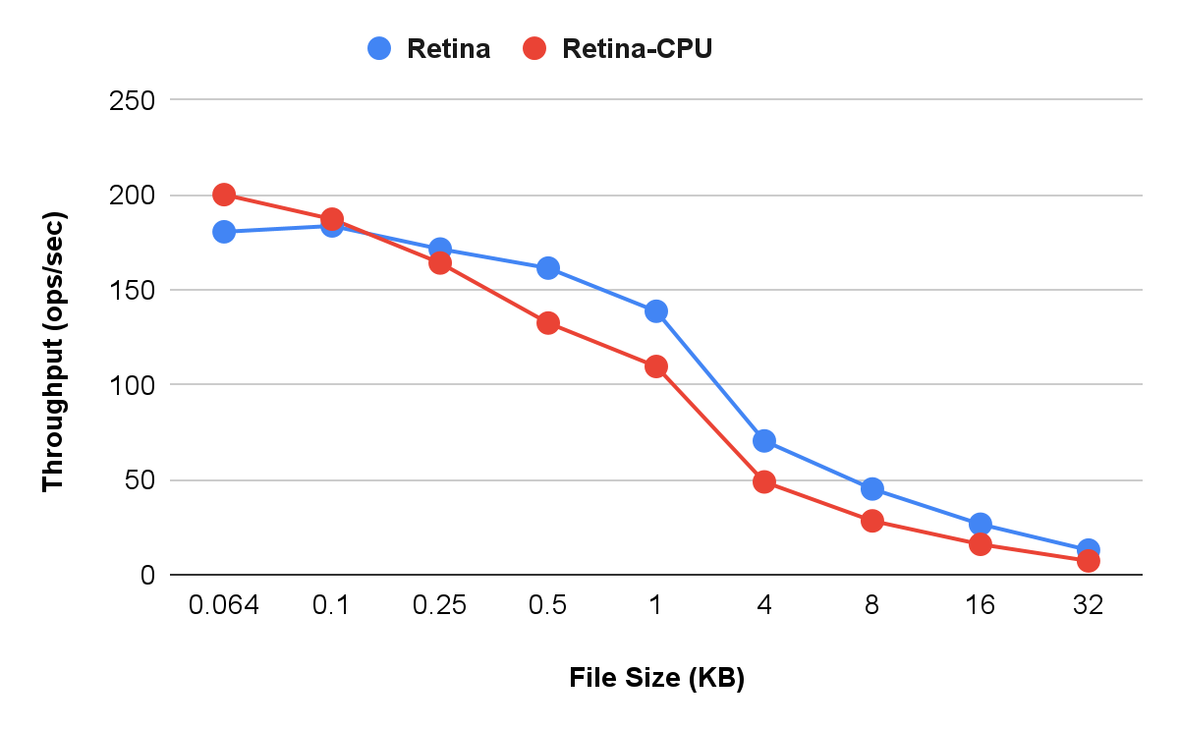
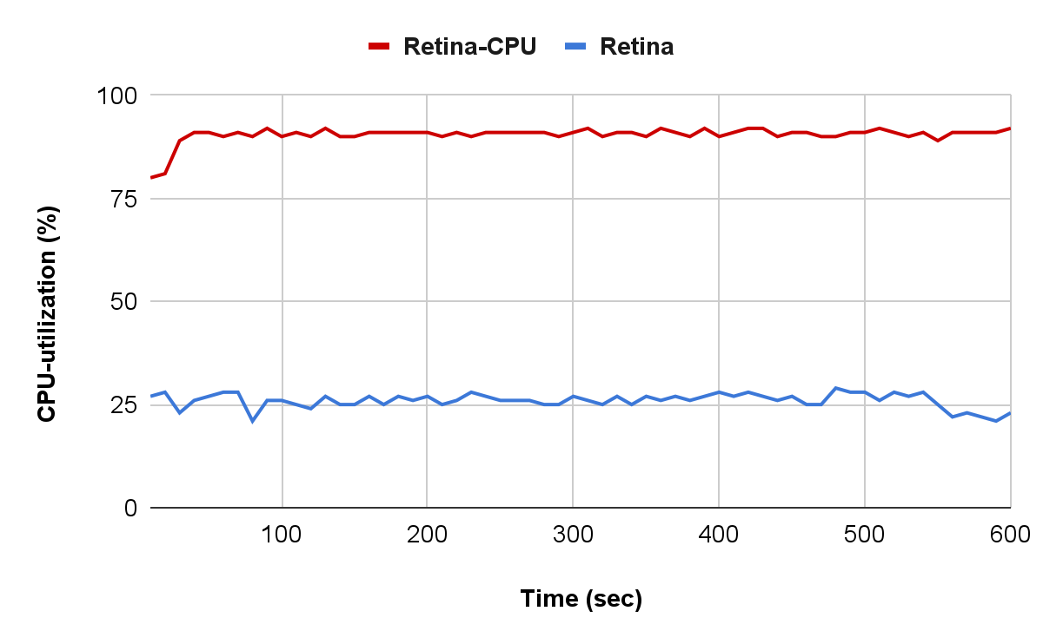
Quote Callout
Snappy Compression (Throughput and CPU Utilization)
O ProcPIPE O CPU
O ProcPIPE O CPU
34

Slide 37
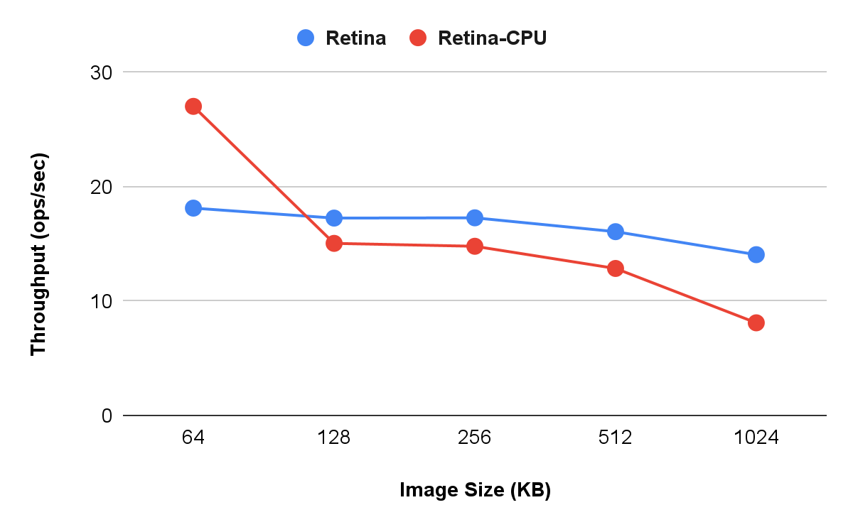
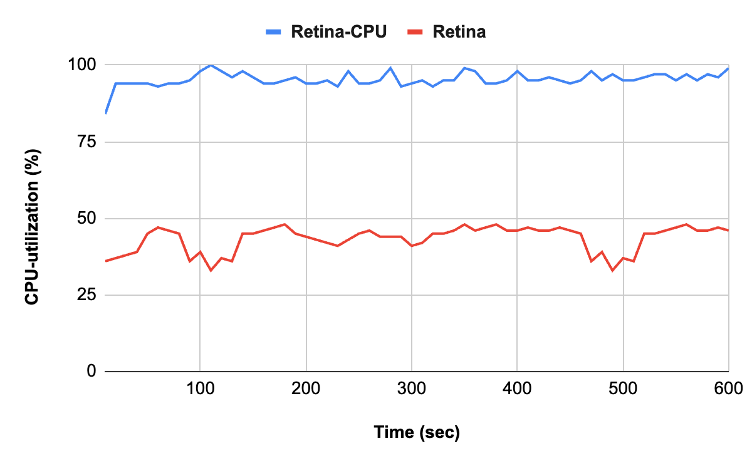
Quote Callout
JPEG Decoder (Throughput and CPU Utilization)
O ProcPIPE O CPU
O ProcPIPE O CPU
35

Slide 38
Quote Callout
Compute Kernels Execution Time vs CPU Execution Time
Size (KB) | Snappy Compression |  | JPEG Decoder
 | CPU (ms) | FPGA(ms) | CPU (ms) | FPGA(ms)
64 | 0.4 | 0.65 | 10 | 27
128 | 0.7 | 0.7 | 37 | 30
256 | 1.2 | 0.8 | 40 | 31
512 | 2.8 | 1.4 | 55 | 36
1024 | 4 | 2.3 | 96 | 45
The benefit of offloading compute to the storage is more pronounced for larger file sizes.
RETINA-FPGA performs up to 70% faster than RETINA-CPU for both Snappy compression and JPEG decoder.
36

Slide 39
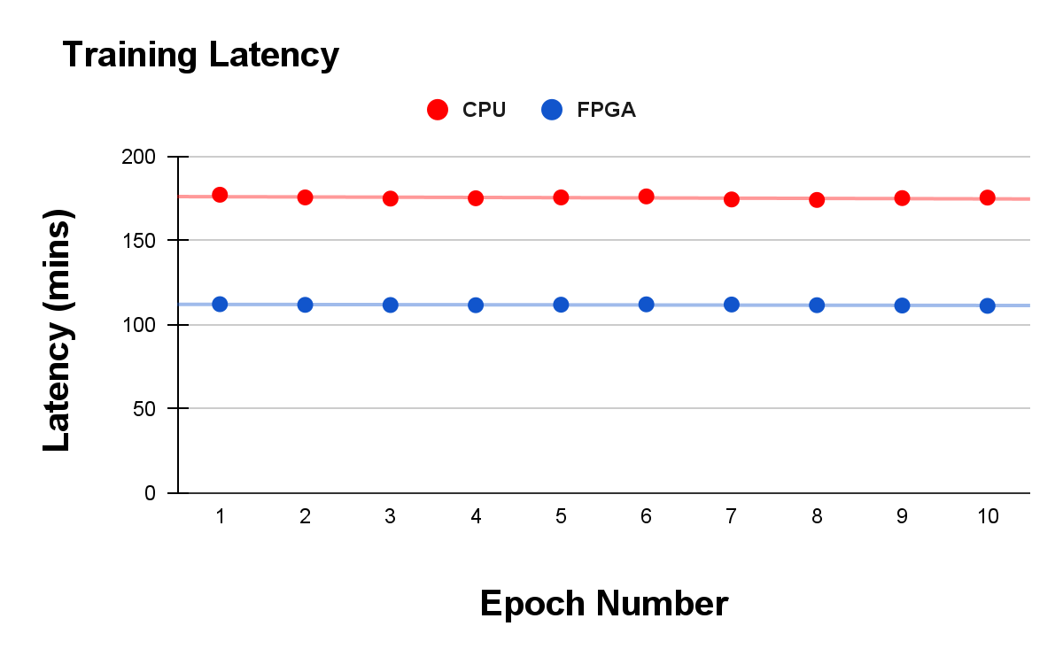
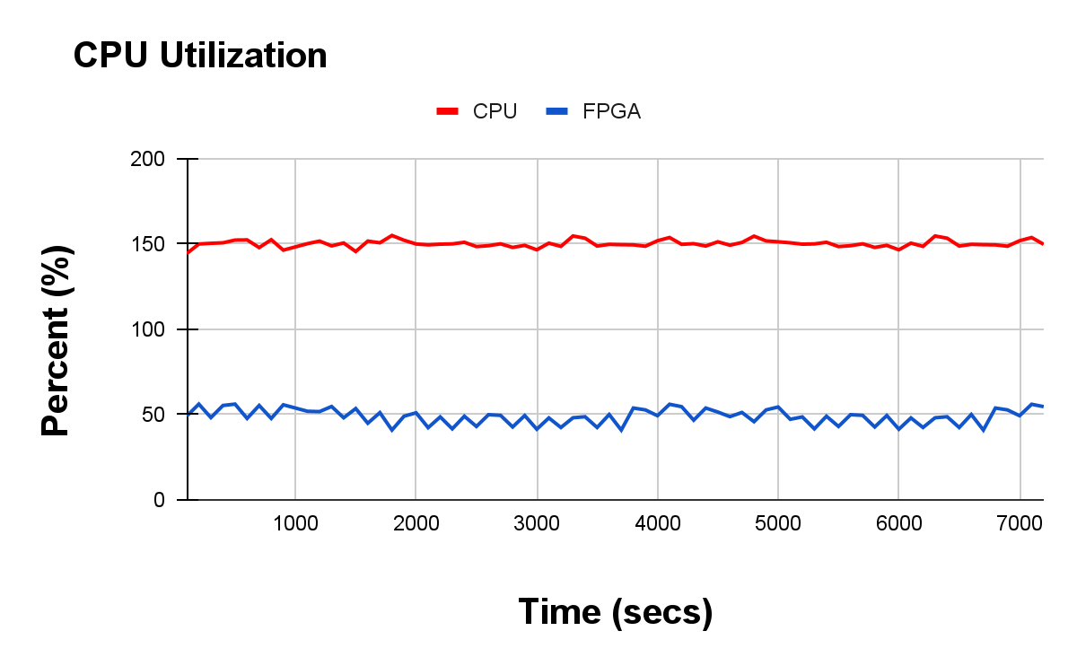
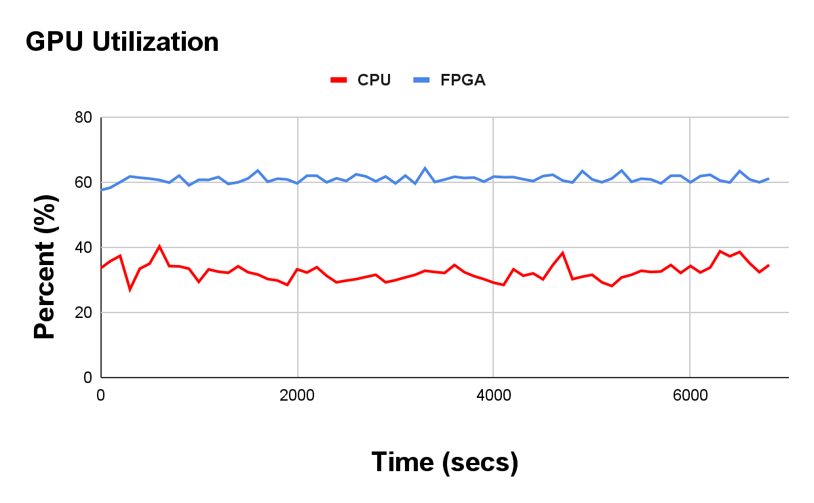
Other Evaluation Numbers
O FPGA O CPU
O FPGA O CPU
O FPGA O CPU
Timing comparison for preprocessing on CPU vs preprocessing done on the SmartSSD FPGA. (feed preprocessed images to training)
37
Notes:
So for these evalu

Slide 40
Conclusion
We proposed RETINA KVS, near-storage compute capable cross-layered KVS designed natively for CSD. (host CPU is the control plane & near storage accelerator is the data plane)
A centralized Arbiter implemented on the FPGA to enable applications to compose compute pipeline dynamically on-fly.
We have filed a patent for the Arbiter Kernel IP and submitted a paper to HotStorage 2023.
Future Work and Improvements:
Test the scalability with a more powerful FPGA. With more instances per compute kernels, we expect to achieve enough parallelization to achieve high throughput numbers.
Increase portability across different CSD architectures.
More optimization on FPGA kernels needed e.g., optimized JPEG decoder
38

Slide 41
THANK YOU

